Slide 1
Machine Learning Project
Dinesh Kripalani

Slide 2
Contents
Where did I get my data from?
What I did with this information
What was I trying to achieve
Was I successful?
Next steps

Slide 3

Gold
Everyone is familiar with Gold. It signifies success, and stature, pride and power. But it also is a commodity that people trade.
Gold stereotypically is considered a stable and a safe-bet during times of inflation, war and uncertainty.

Slide 4
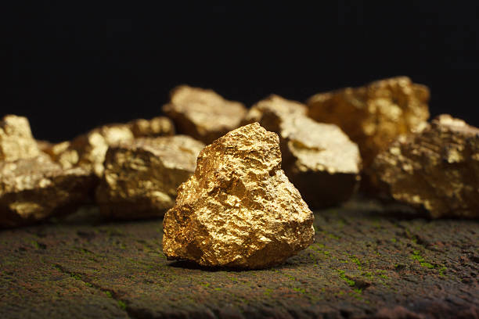
Data Sources:
Nasdaq commodity historical data.
Their website allowed me to download the last 10 years of market moves.

Slide 5
Gold is still the ultimate store of wealth. It's the world's only true money. And there isn't much of it to go around. All of it ever mined would fit into a small building—a 56 foot cube. The annual world production would fit into a 14 foot cube, roughly the size of an ordinary living room.. If each Chinese citizen were to buy just one ounce, it would take up the annual supply for the next 200 years.
“
”
- Mark Nestmann

Slide 6
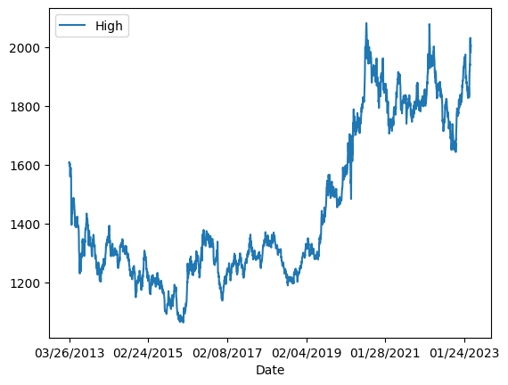
With this data
Got this beautiful plot using this dataframe
I had to flip the data, so that rather than looking at the data in hindsight, it would give us more foresight.
Removed all null values so as to not confuse or skew the model.
Dropped the whole volume column as it had numerous null value entries.

Slide 7
The date split
I wanted to get the data split according to a certain date. From the 1st of Jan 2022. This is approximately a 87.5:12.5 split for testing and training.Which is very close to what we normally would do using only 20% of the data to test.
My first model was going to be a Linear Regression model.
87.5%
12.5%

Slide 8
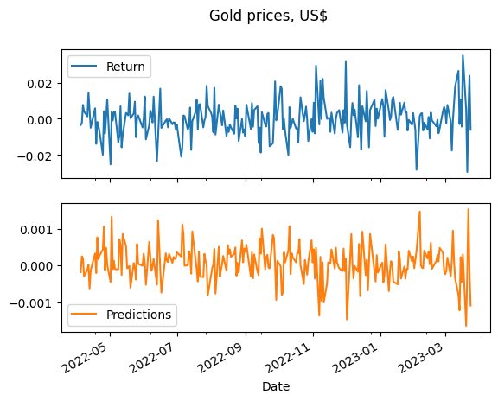
At first glance, the model looked good

Slide 9
But my r2 score was -14%, and on closer inspection…. The model was a bit off
Since the RandomForest Regressor was said to be more immune to noise, I tried this.
But that only made the r2 score go lower then negative 14.
So I tried to overlap the plots to see how big of a difference there was.
Returns were used, since it is more Stationary data compared to price.

Slide 10
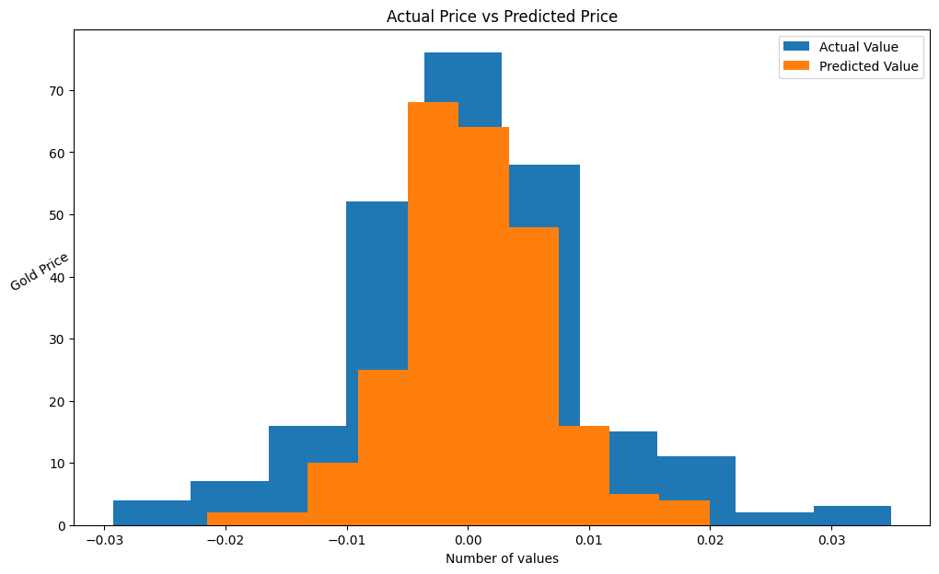
So I tried a RandomForest Regressor, but that only made the r2 score go lower then negative 14.
So I tried to overlap the plots to see how far I was off.

Slide 11
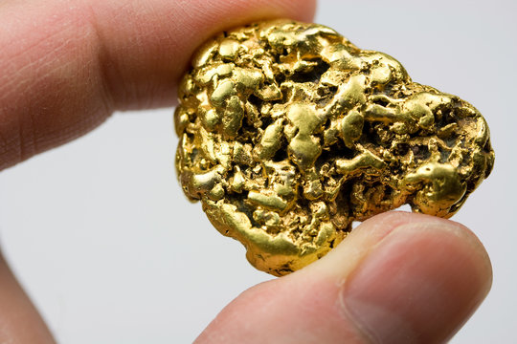
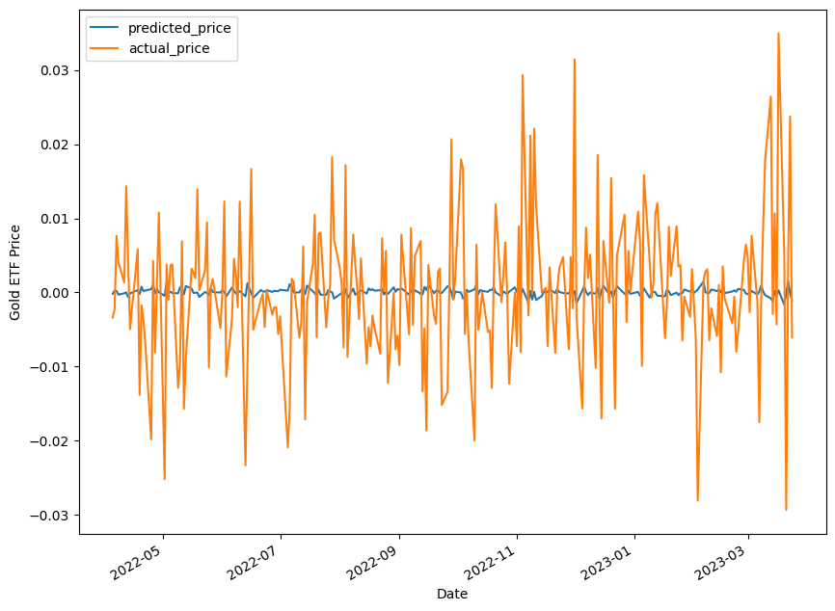
So instead of using just the previous days data to predict my model I tried using a 3 and 9 day moving average respectively. It didn’t improve the models accuracy.

Slide 12
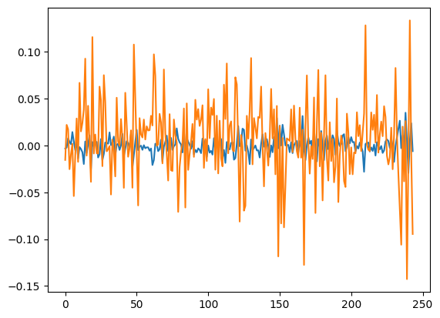
With Mean Absolute Error, the errors actually increased.

Slide 13
What I hoped to achieve
I was looking at making this model to be able to predict the future value of gold, as an investor or just someone who is trying to preserve their wealth due to inflation.
I came away with a better understanding on machine learning models, and how different dependent variables are so important in predicting a certain price value a single one.

Slide 14
Conclusion
Although unsuccessful in my first model, I was told that there is no perfect way to predict future gold prices, or stock prices for that matter, because these commodities depend on a hundred other factors that affect its daily, weekly, monthly and yearly movements.
Next steps
Adding in different dependent variables would be interesting to see if I can improve the coefficient of determination, and accuracy of the model. Some examples I would be eager to try are inflation, SPX, silver prices.

